Slide 1
Transistor: Construction and Operation

Slide 2
Introduction
This chapter will help you to learn:
The physical structure of the bipolar transistor and how it works.
How the voltage between two terminals of the transistor controls the current that flows through the third terminal, and the equations that describe these current-voltage relationships.
How to analyze and design circuits that contain bipolar transistors, resistors, and dc sources.
How the transistor can be used to make an amplifier.
The three basic ways for connecting a BJT to be able to construct amplifiers with different properties.
How the transistor can be used to design switch (for example: logic circuits).

Slide 3
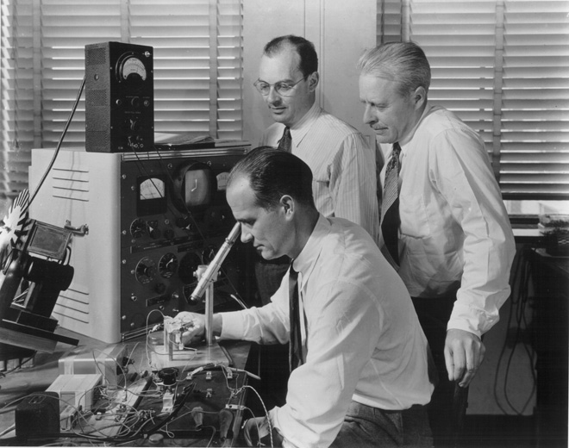
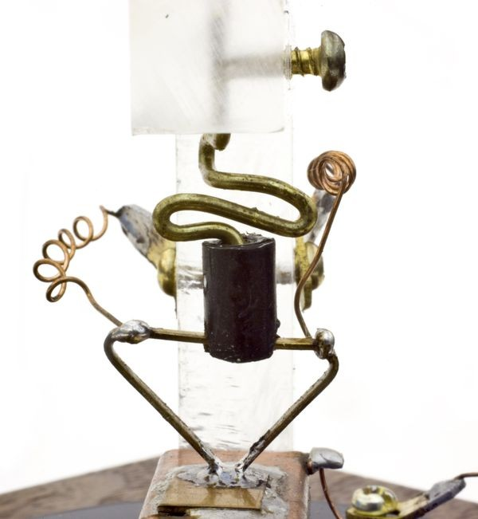
Introduction
On December 23, 1947, Dr. S. William Shockley, Walter H. Brattain, and John Bardeen demonstrated the amplifying action of the first transistor at the Bell Telephone Laboratories.
In early 1948, Dr. S. William Shockley came up with refined transistor called the Bipolar Junction Transistor (BJT).
On June 30, 1948, Bell Labs officially announced the first transistor at a press conference in New York.
The first transistor used two closely spaced gold contacts pressed onto the surface of a slab of high-purity germanium
Shockley, Bardeen and Brattain shared the 1956 Nobel Prize in Physics for the transistor.

Slide 4
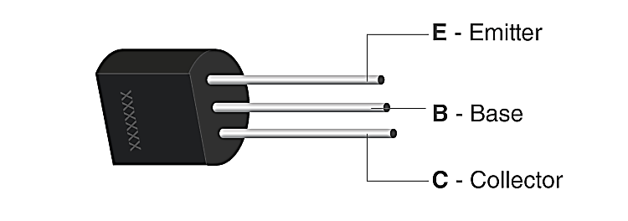
Introduction
A transistor is a three terminal device.
It is used to amplify, Oscillates, or Switches the flow of current between two terminals.
Advantages: Transistor has few advantages over tube devices
Smaller and lightweight.
No heater requirement.
A rugged construction.
Takes less power
Require no warm-up period
Lower operating voltages

Slide 5
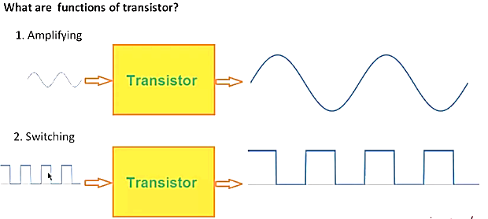
Applications of transistors
Transistor are mostly used than diodes because they can be used in a multitude of applications:
signal amplification
design of digital logic and memory circuits.

Slide 6
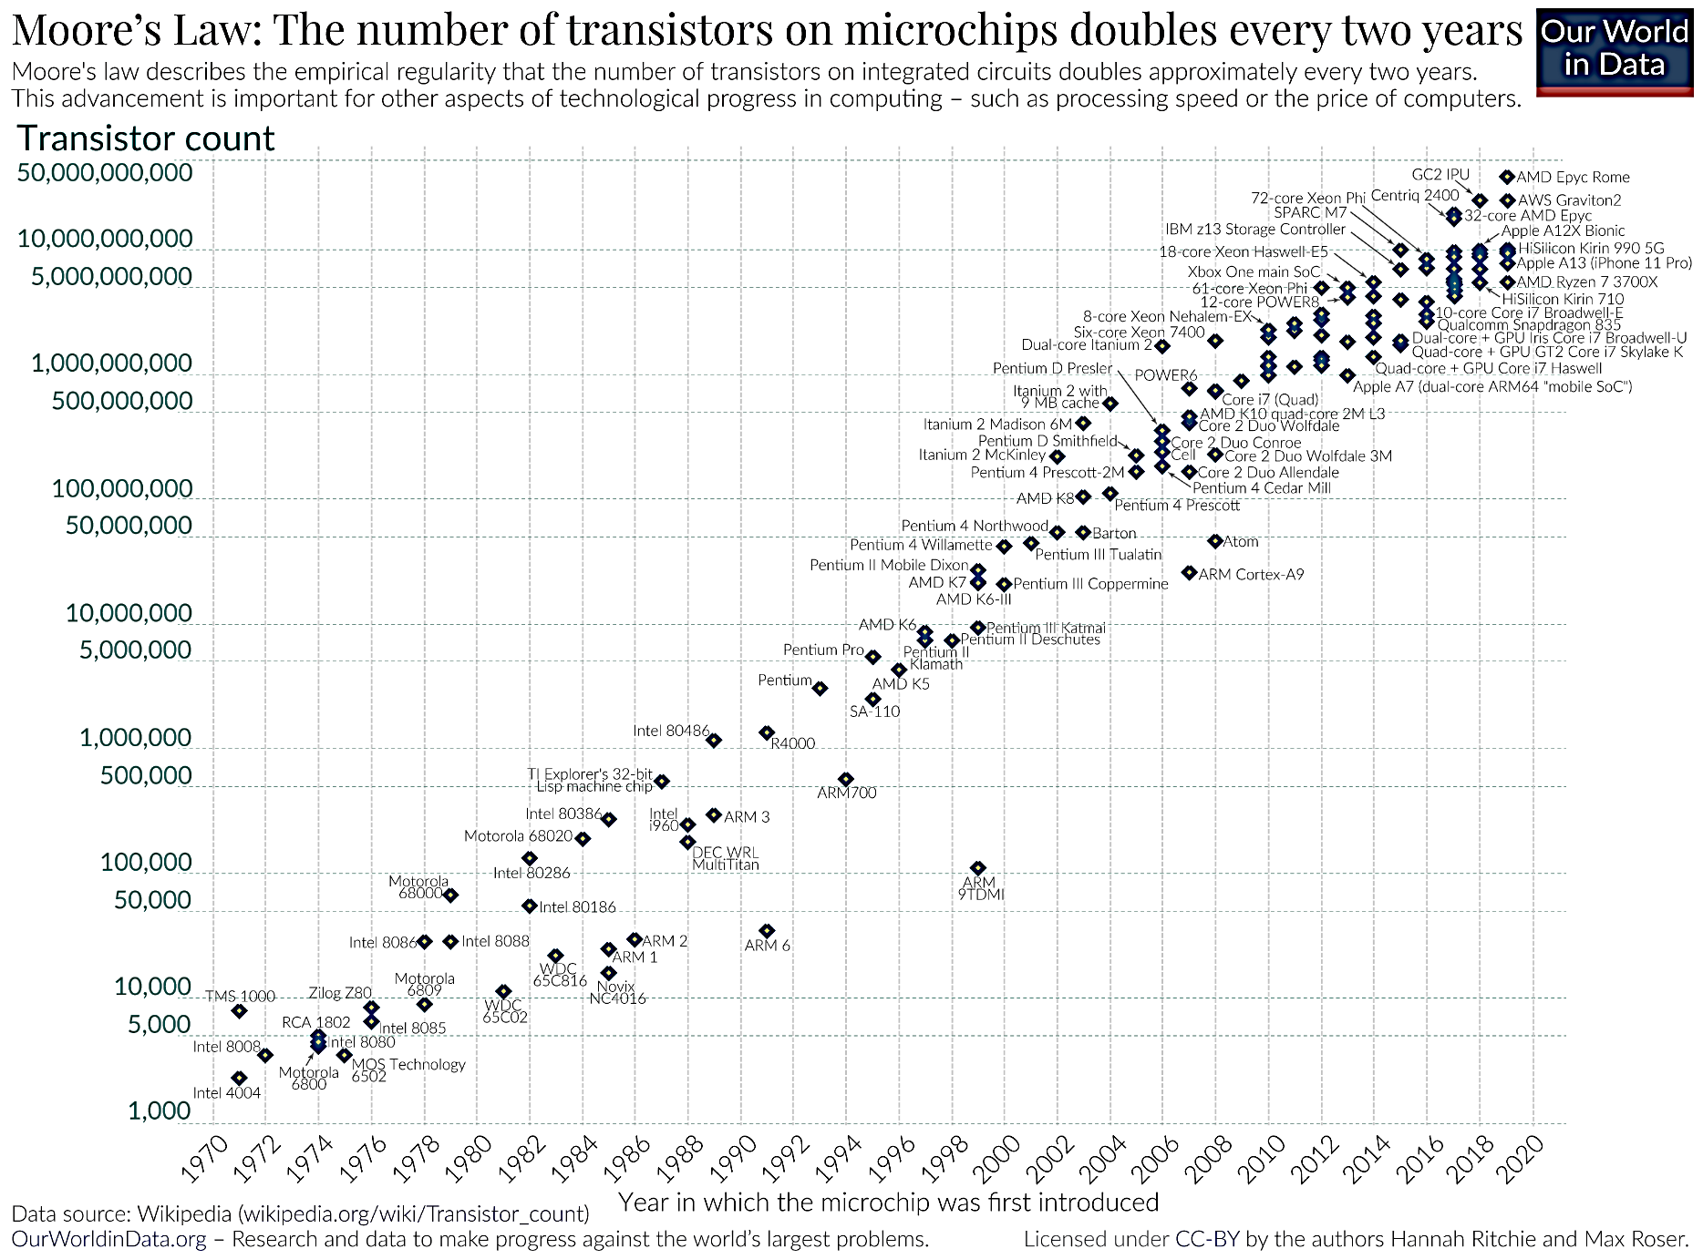
Applications of transistor

Slide 7
Transistor Material
The transistor is an arrangement of semiconductor materials that share common physical boundaries.
Materials most commonly used are
Silicon (Si)
Gallium-arsenide (GaAs)
And germanium (Ge)

Slide 8
Classification of Transistors
Transistor
Point Contact Transistor
Bipolar Junction Transistor (BJT)
Field Effect Transistor (FET)
PNP Transistor
NPN Transistor
Junction Gate Field-Effect Transistor (JFET)
Metal Oxide Silicon Field Effect Transistor (MOSFET)
Depletion
Depletion
Enhancement
N-Channel
N-Channel
N-Channel
P-Channel
P-Channel
P-Channel

Slide 9
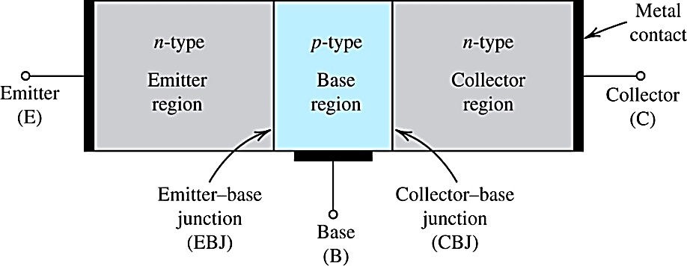
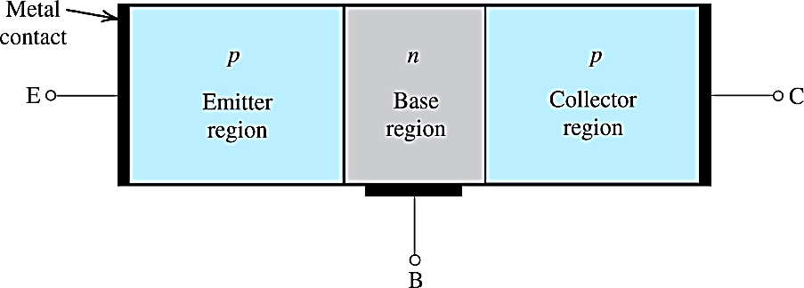
BJT Structure
0.150 in
0.150 in
0.001 in
0.001 in
NPN-type
PNP-type
Three terminals of transistors are E for emitter , C for collector , and B for base.
The abbreviation of bipolar junction transistor is BJT.
If only one carrier is employed (electron or hole), it is considered a unipolar device such as Field Effect Transistor (FET)
Since both electrons and holes participate in the injection process into oppositely polarized materials of transistor, it is called bipolar.
Width: C>E>B and Doping: E>C>B

Slide 10
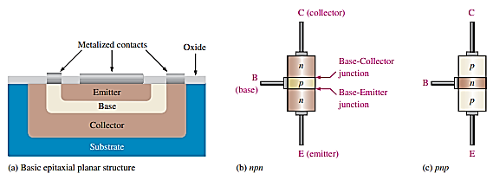
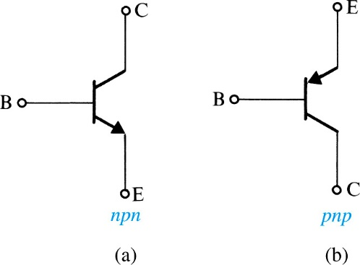
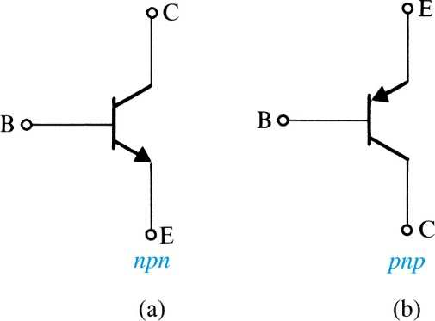
BJT Structure
NPN-type
PNP-type
Transistor consists of two pn-junctions:
emitter-base junction (EBJ)
collector-base junction (CBJ)
The arrow on schematic symbol is important because:
Identify the component terminal
The arrow is always drawn on the emitter terminal.
The arrow always points toward n-type material
If the arrow point toward base, transistor is pnp type. If it points toward emitter, transistor is npn type.

Slide 11
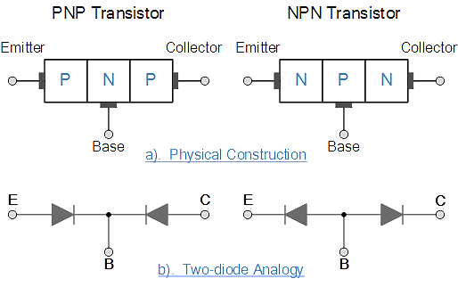
BJT Structure

Slide 12
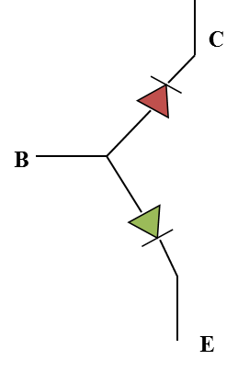
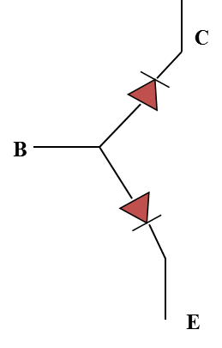
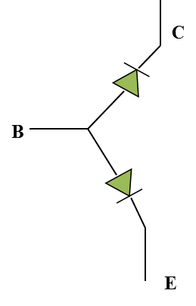
Modes of Operation
Active
Operating range of the amplifier.
Base-Emitter Junction forward biased.
Collector-Base Junction reverse biased
Cutoff
The amplifier is basically off. There is voltage but little current.
Both junctions reverse biased
Saturation
The amplifier is full on. There is little voltage but lots of current.
Both junctions forward biased

Slide 13
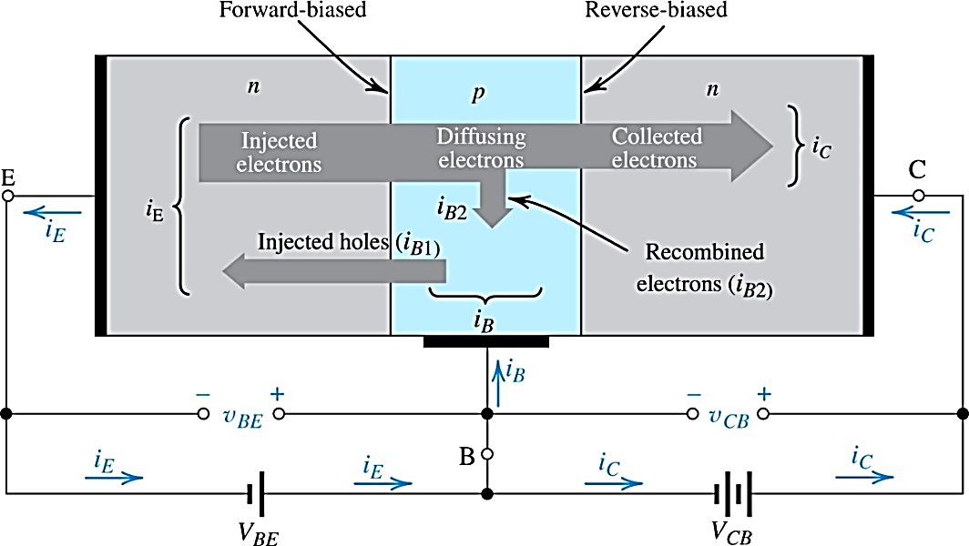
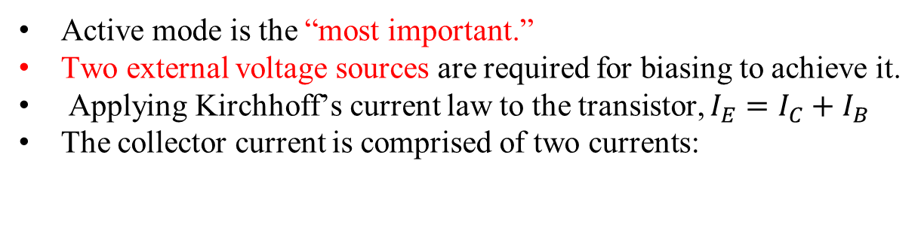
NPN Active Mode of Operation
Active mode is the “most important.”
Two external voltage sources are required for biasing to achieve it.
Applying Kirchhoff’s current law to the transistor, $I_{E}=I_{C}+I_{B}$
The collector current is comprised of two currents:
Notes:
VBE causes the p-type base to be higher in potential than the n-type emitter, thus forward-biasing the emitter–base junction. The collector–base voltage VCB causes the n-type collector to be at a higher potential than the p-type base, thus reverse-biasing the collector–base junction.

Slide 14
NPN Cutoff Mode of Operation
REVERSE-BIASED
REVERSE-BIASED
I_{E}=0
I_{C}=0
I_{B}=0
EMITTER
COLLECTOR
BASE
+ V_{BE} -
- V_{CB} +

Slide 15
NPN Saturation Mode of Operation
FORWARD-BIASED
FORWARD-BIASED
I_{E}
I_{C}
EMITTER
I_{B}≅0
COLLECTOR
BASE
- V_{BE} +
+V_{CB} -

Slide 16
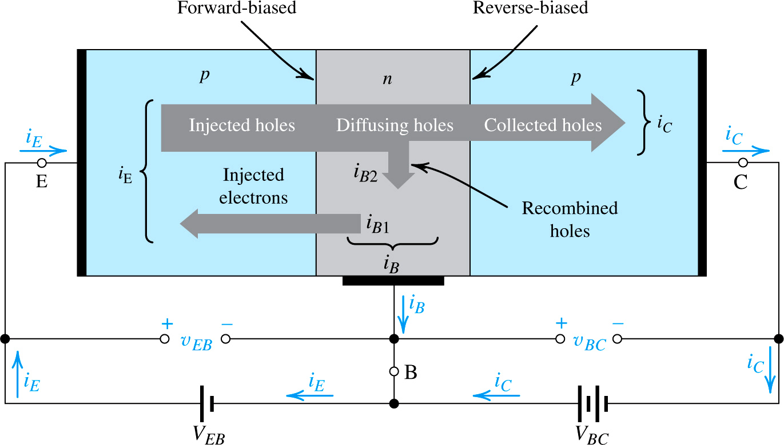
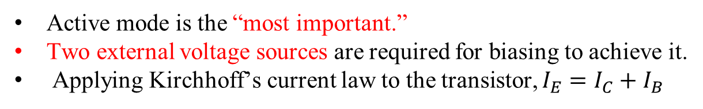
PNP Active Mode of Operation
Active mode is the “most important.”
Two external voltage sources are required for biasing to achieve it.
Applying Kirchhoff’s current law to the transistor, $I_{E}=I_{C}+I_{B}$
Notes:
VBE causes the p-type base to be higher in potential than the n-type emitter, thus forward-biasing the emitter–base junction. The collector–base voltage VCB causes the n-type collector to be at a higher potential than the p-type base, thus reverse-biasing the collector–base junction.

Slide 17
PNP Cutoff Mode of Operation
BASE
REVERSE-BIASED
REVERSE-BIASED
I_{E}=0
I_{C}=0
I_{B}=0
EMITTER
COLLECTOR
- V_{EB} +
+ V_{BC} -

Slide 18
PNP Saturation Mode of Operation
FORWARD-BIASED
FORWARD-BIASED
I_{E}
I_{C}
EMITTER
I_{B}≅0
COLLECTOR
BASE
+ V_{EB} -
- V_{BC} +

Slide 19
BJT Configuration
In the electronic circuit, there are three possible ways to connect BJT, where one terminal being common to both input and output signals.
Common Base Configuration – has Voltage Gain but no Current Gain.
Common Emitter Configuration – has both Current and Voltage Gain (most widely used).
Common Collector Configuration – has Current Gain but no Voltage Gain

Slide 20
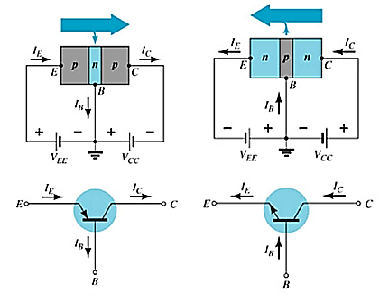
Common Base Configuration
The base is common to both input (emitter–base) and output (collector–base) of the transistor.

Slide 21
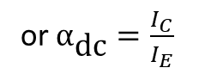
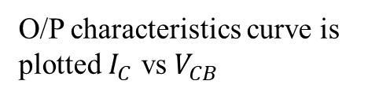
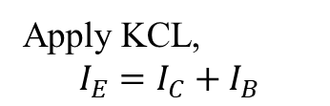
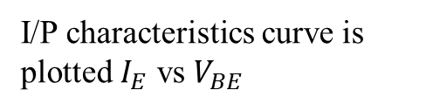
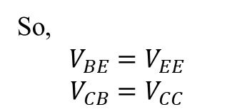
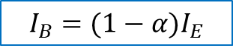
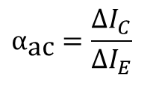
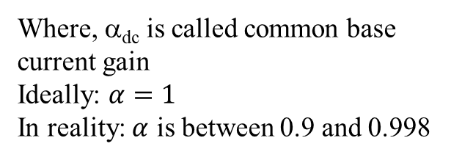
Common Base Configuration
I/P characteristics curve is plotted $I_{E}$ vs $V_{BE}$
O/P characteristics curve is plotted $I_{C}$ vs $V_{CB}$
Input
Weak Signal
Output
Amplified Signal
Here, for the biasing voltages:
EB diode is forward bias
BC diode is reversed bias
Number of electrons reaching the collector region is directly proportional to the number of electrons injected or crossing the base region.
So,
$$V_{BE}=V_{EE}$$
$$V_{CB}=V_{CC}$$
or $α_{\text{dc}}=\frac{I_{C}}{I_{E}}$
I_{C} = α_{dc} I_{E}
Where, α_{dc} is called common base current gain
Ideally: $α=1$
In reality: $α$ is between 0.9 and 0.998
Apply KCL,
$$I_{E}=I_{C}+I_{B}$$
$$α_{\text{ac}}=\frac{ΔI_{C}}{ΔI_{E}}$$
Alpha (α) in the AC mode:
$$I_{B}=(1−α)I_{E}$$

Slide 22
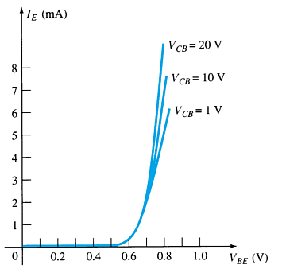
Common Base Configuration
Input Characteristics:
Input
Weak Signal
Output
Amplified Signal
This curve shows the relationship between of input current (I_{E}) to input voltage (V_{BE}) for three output voltage (V_{CB}) levels.

Slide 23
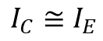
Common Base Configuration
Output Characteristics
I_{C} = α_{dc} I_{E}
$$I_{C}≅I_{E}$$
This graph demonstrates the output current (I_{C}) to an output voltage (V_{CB}) for various levels of input current (I_{E}).

Slide 24
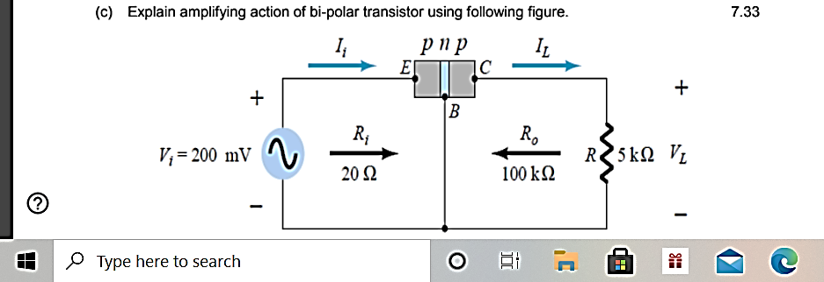
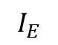
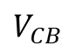
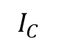
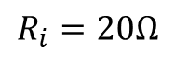
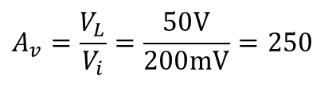
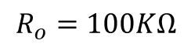
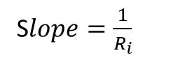
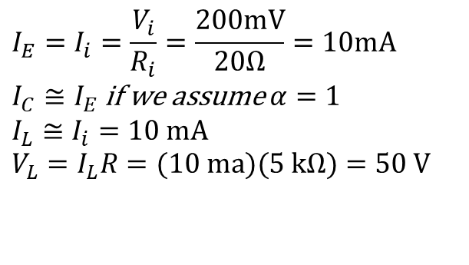
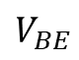
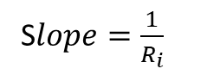
Transistor Amplification
$$I_{E}$$
$$I_{C}$$
S$lope=\frac{1}{R_{i}}$
$$R_{i}=20Ω$$
$$R_{o}=100KΩ$$
S$lope=\frac{1}{R_{i}}$
$$V_{BE}$$
$$V_{CB}$$
Currents and Voltages:
Voltage Gain:
$$I_{E}=I_{i}=\frac{V_{i}}{R_{i}}=\frac{200mV}{20Ω}=10mA$$ $I_{C}≅I_{E}$ if we assume $α=1$ $$I_{L}≅I_{i}=\text{10 }\text{mA} \\ V_{L}=I_{L}R=(\text{10 }\text{ma})(\text{5 }\text{kΩ})=\text{50 }\text{V}$$
$$A_{v}=\frac{V_{L}}{V_{i}}=\frac{50V}{200mV}=250$$

Slide 25
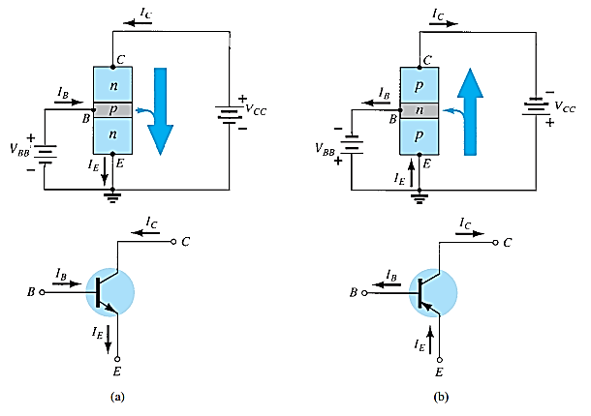
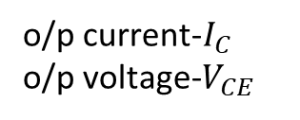
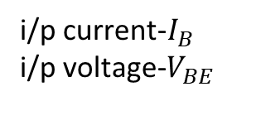
Common–Emitter Configuration
The emitter is common to both input (base-emitter) and output (collector-emitter).
The input is on the base and the output is on the collector.
i/p current-$I_{B}$
i/p voltage-$V_{BE}$
o/p current-$I_{C}$
o/p voltage-$V_{CE}$
Notation and symbols used with the common-emitter configuration: (a) npn transistor; (b) pnp transistor.

Slide 26
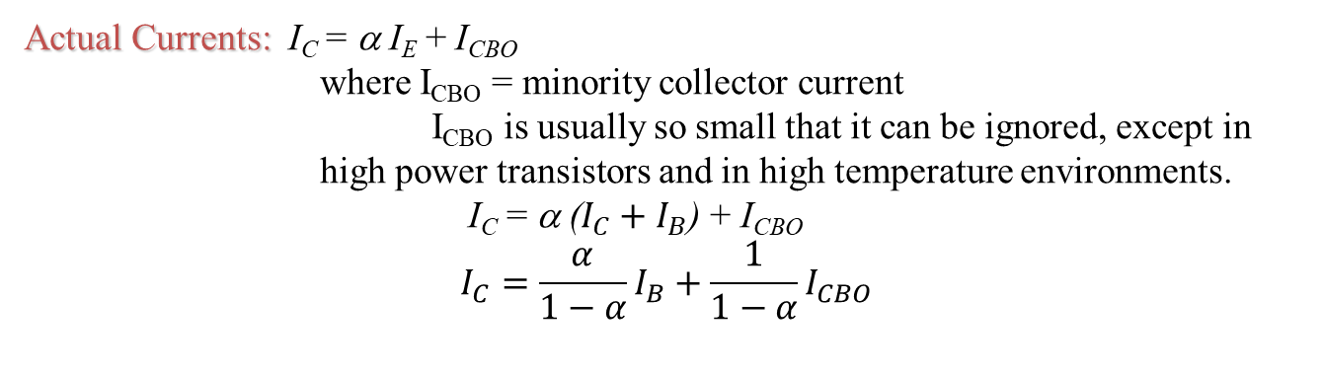
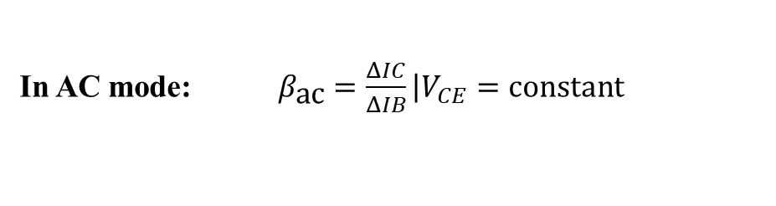
Common-Emitter Amplifier Currents
Ideal Currents: I_{E} = I_{C} + I_{B} and I_{C} = α I_{E}
Actual Currents: I_{C} = α I_{E} + I_{CBO}
where I_{CBO} = minority collector current
I_{CBO} is usually so small that it can be ignored, except in high power transistors and in high temperature environments.
I_{C} = α ($I_{C}+I_{B}$) + I_{CBO}
$$I_{C}=\frac{α}{1−α}I_{B}+\frac{1}{1−α}I_{CBO}$$
Beta (β)
β represents the amplification factor of a transistor. (β is sometimes referred to as h_{fe}, a term used in transistor modeling calculations)
In DC mode: $β_{\text{dc}}=\frac{I_{C}}{I_{B}}$
In AC mode: $β_{\text{ac}}=\frac{ΔIC}{ΔIB}\left|V_{CE}=\text{constant}\right.$

Slide 27
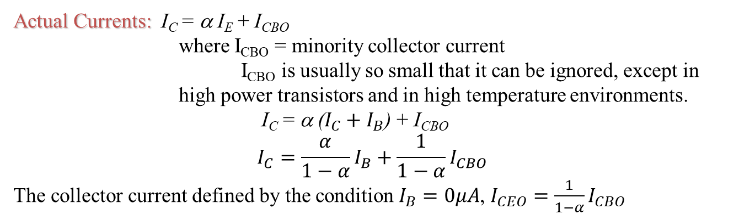
Common-Emitter Amplifier Currents
Ideal Currents: I_{E} = I_{C} + I_{B} and I_{C} = α I_{E}
Actual Currents: I_{C} = α I_{E} + I_{CBO}
where I_{CBO} = minority collector current
I_{CBO} is usually so small that it can be ignored, except in high power transistors and in high temperature environments.
I_{C} = α ($I_{C}+I_{B}$) + I_{CBO}
$$I_{C}=\frac{α}{1−α}I_{B}+\frac{1}{1−α}I_{CBO}$$
The collector current defined by the condition $I_{B}=0μA$, $I_{CEO}=$ $\frac{1}{1−α}I_{CBO}$
Beta (β)
β represents the amplification factor of a transistor. (β is sometimes referred to as h_{fe}, a term used in transistor modeling calculations)
In DC mode: $β_{\text{dc}}=\frac{I_{C}}{I_{B}}$
In AC mode: $β_{\text{ac}}=\frac{ΔIC}{ΔIB}\left|V_{CE}=\text{constant}\right.$

Slide 28

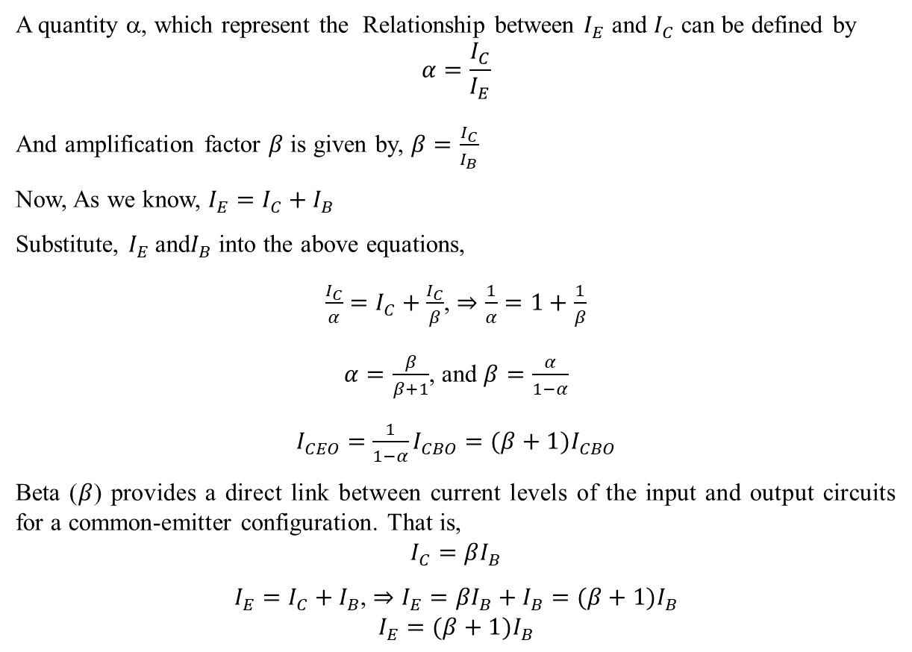
Relationship Between Alpha($α$) Beta (β)
A quantity α, which represent the Relationship between $I_{E}$ and $I_{C}$ can be defined by
$$α=\frac{I_{C}}{I_{E}}$$
And amplification factor $β$ is given by, $β=\frac{I_{C}}{I_{B}}$
Now, As we know, $I_{E}=I_{C}+I_{B}$
Substitute, $I_{E}$and$I_{B}$ into the above equations,
$\frac{I_{C}}{α}=I_{C}+\frac{I_{C}}{β}$, $⇒\frac{1}{α}=1+\frac{1}{β}$
$α=\frac{β}{β+1}$, and $β=\frac{α}{1−α}$
$I_{CEO}=$ $\frac{1}{1−α}I_{CBO}=(β+1)I_{CBO}$
Beta ($β$) provides a direct link between current levels of the input and output circuits for a common-emitter configuration. That is,
$$I_{C}=βI_{B}$$
$I_{E}=I_{C}+I_{B}$, $⇒I_{E}={βI}_{B}+I_{B}=(β+1)I_{B}$
$$I_{E}=(β+1)I_{B}$$

Slide 29
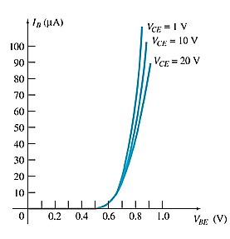
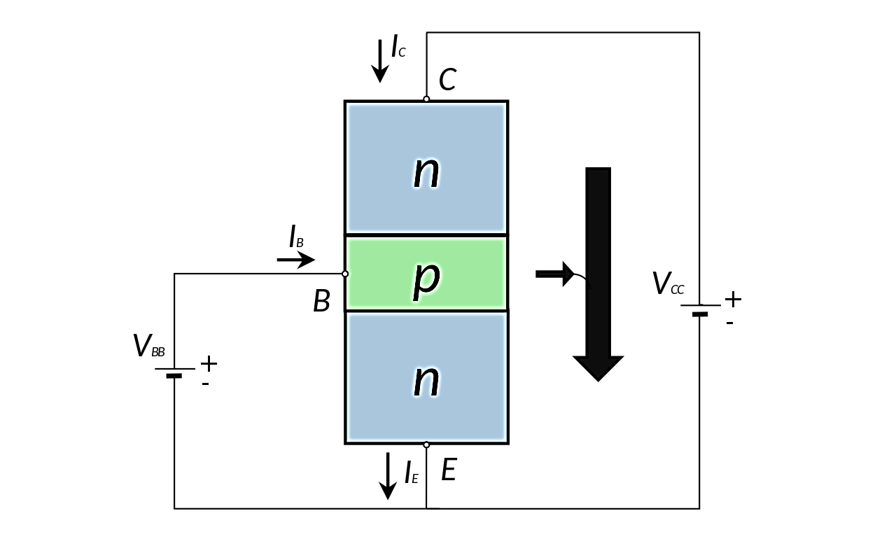
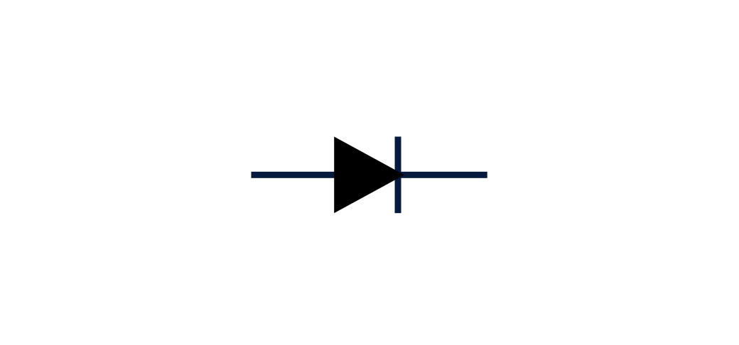
Common-Emitter Characteristics
Base Characteristics

Slide 30





Common-Emitter Characteristics
$I_{C}$ vs $V_{CE}$ for different level of $I_{B}$
I_{C} = α I_{E} + I_{CBO}
I_{C} =$βI_{B}+(β+1)I_{CBO}$
When, $I_{B}=0μA$
$I_{CEO}=$ $\frac{1}{1−α}I_{CBO}=(β+1)I_{CBO}$
I_{c}=1.5 mA
Collector Characteristics

Slide 31

Beta (β)
Determining β from a Graph

Slide 32

Common–Collector Configuration
The input is on the base and the output is on the emitter.
Notation and symbols used with the common-collector configuration: (a) pnp transistor; (b) npn transistor.

Slide 33
Common–Collector Configuration
The characteristics are similar to those of the common-emitter configuration, except the vertical axis is I_{E}.

Slide 34

Operating Limits for Each Configuration
V_{CE} is at maximum and I_{C} is at minimum (I_{Cmax}= I_{CEO}) in the cutoff region.
I_{C} is at maximum and V_{CE} is at minimum (V_{CE max} = V_{CEsat} = V_{CEO}) in the saturation region.
The transistor operates in the active region between saturation and cutoff.

Slide 35
Power Dissipation
Common-base:
Common-emitter:
Common-collector:

Slide 36

Transistor Specification Sheet

Slide 37

Transistor Specification Sheet

Slide 38


Transistor Testing
Curve Tracer
Provides a graph of the characteristic curves.
DMM
Some DMMs measure β_{DC} or h_{FE}.
Ohmmeter

Slide 39

Transistor Terminal Identification

